Slide 1
Ethics and Technology
Paul B. Thompson
W.K. Kellogg Professor of Agricultural, Food and Community Ethics

Slide 2
Ethics
Communication
Thinking
Talking, reasoning and learning in a group.
Ethics is a reasoning process designed to explore and answer questions about a proposed course of action that take the form “Is that a good idea?”

Slide 3
Ethics
… a broad & inclusive review of the reasons and purposes…
… sensitive to reasons why someone might contest or oppose …
Ethics is a reasoning process designed to explore and answer questions about a proposed course of action that take the form “Is that a good idea?”
Ethics as a Subfield in Philosophy Departments
Develop theory & principles for proffering & accepting reasons.

Slide 4
Legitimate or ethically binding reasons…
… promote the greatest total satisfaction or happiness for all affected parties
For example…
… always respect the dignity and rights of other people
Take these theories of ethical reasoning as indicators for “hot button” issues in developing & implementing technology
Technology
Infrastructure
Ethics as a Subfield in Philosophy Departments
Develop theory & principles for proffering & accepting reasons.

Slide 5
Technological Trajectories
A socio-technical system is always the work of a social network.
A trajectory links actors who will play complementary roles over time. It is the spine of network.
Actors whose interests are adversely affected may form a counter-network.
Technologies develop over time.
The metaphor of a trajectory emphasizes the relationship between the inherent possibility of a technical form or capability & forces in the socio-economic environment that affect the realization of its capabilities.
Actors organized in a counter-network may envision an entirely different trajectory.

Slide 6
Technological Trajectories
An important technology is always the work of a social network.
A trajectory links actors who will play complementary roles over time. It is the spine of network.
Where do we want to be?
What are the power relationships? Whose rights were affected?
Technologies develop over time.
One component of technological ethics concerns the endpints of the various trajectories.
The metaphor of a trajectory emphasizes the relationship between the inherent possibility of a technical form or capability & forces in the socio-economic environment that affect the realization of its capabilities.
Actors organized in a counter-network may envision an entirely different trajectory.
A final component of technological ethics concerns the process (including duties of actors) involved in negotiating network conflicts.
Another component concerns the starting points and trace of the trajectory.

Slide 7
General Problems with Bioenergy Trajectories
Food vs. Fuel
Land Use
Environmental
Social

Slide 8
1 Biofuels development should not be at the expense of human rights
2 Biofuels should be environmentally sustainable
3 Biofuels should contribute to a reduction of greenhouse gas emissions
4 Biofuels should adhere to fair trade principles
5 Costs and benefits of biofuels should be distributed in an equitable way

Slide 9
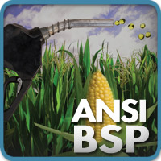
1 Biofuels development should not be at the expense of human rights
2 Biofuels should be environmentally sustainable
3 Biofuels should contribute to a reduction of greenhouse gas emissions
4 Biofuels should adhere to fair trade principles
5 Costs and benefits of biofuels should be distributed in an equitable way
All these terms imply criteria that require further specification.

Slide 10
Sustainability
The Development
of an Idea
Makes the most efficient use of available resources
Provides a basis for stable societies
Circa 1825

Slide 11
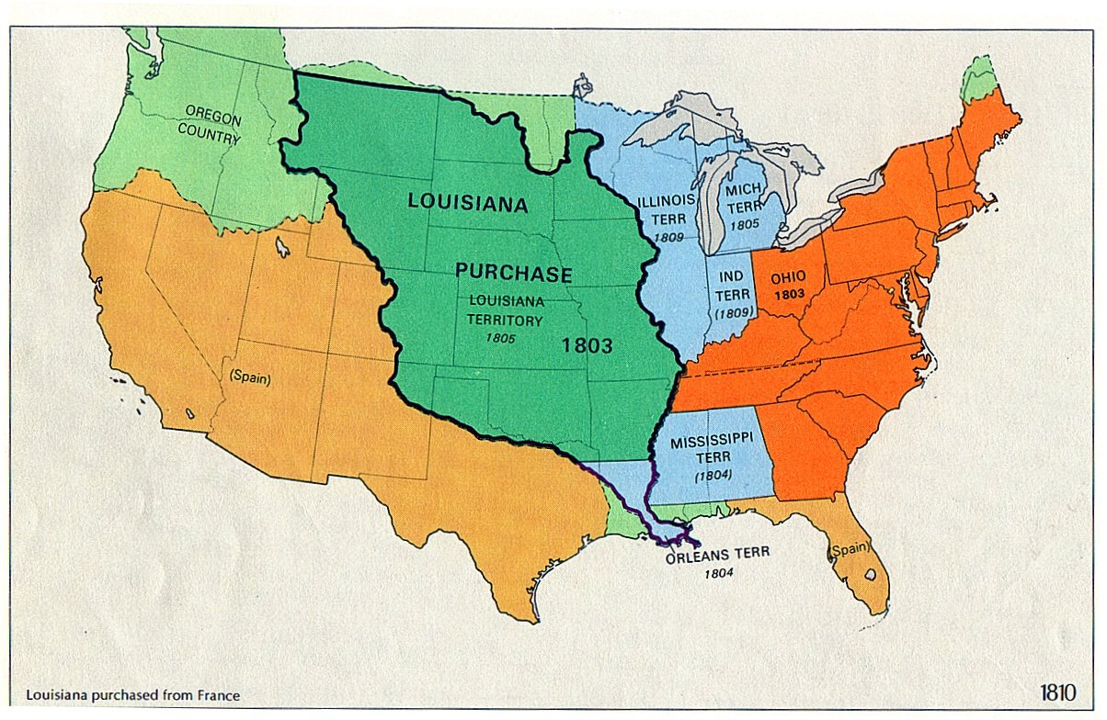
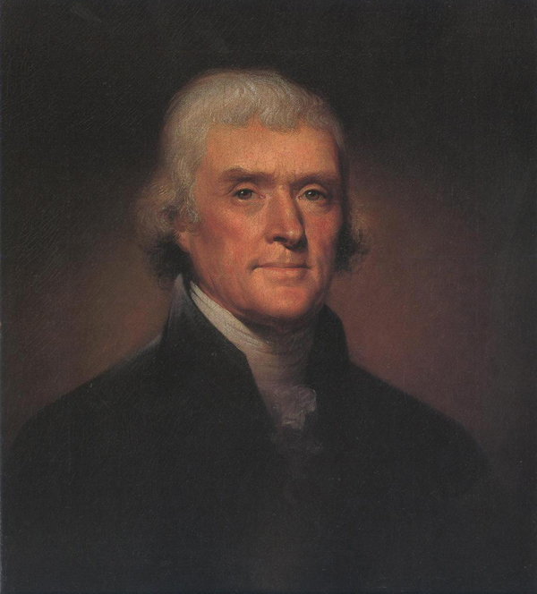
With ample land to the west, “skimming” topsoil followed by ever westward migration made economic sense.
Makes the most efficient use of available resources
Provides a basis for stable societies
“Cultivators of the earth are the most valuable citizens. They are the most vigorous, the most independent, the most virtuous, and they are tied to their country and wedded to its liberty and interests by the most lasting bonds.”
Letter to John Jay
1786
Unless your interest was to ensure that the localities of the new republic would have a stable source of defense, tax revenue and the other public goods tied to place prosperity.

Slide 12
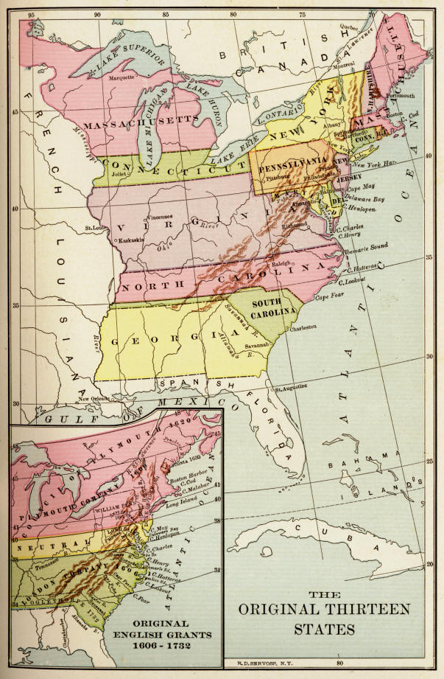
Jefferson had witnessed outmigration by tradesmen and manufacturers during the revolutionary period.
Farmers do not have portable assets.
They are “tied to their country and wedded to its liberty by the most lasting bonds.”
Notes:
Departure of manufacturing from northern colonies during and after the Revolution.

Slide 13
Within the historical context, this view assumes fungibility between natural and financial capital. It was a form of “weak sustainability”
With ample land to the west, “skimming” topsoil followed by ever westward migration made economic sense.
“Cultivators of the earth are the most valuable citizens. They are the most vigorous, the most independent, the most virtuous, and they are tied to their country and wedded to its liberty and interests by the most lasting bonds.”
Letter to John Jay
1786
Jefferson was concerned about the underlying integrity of the new republic’s key political institutions—perhaps a form of “social sustainability.”

Slide 14
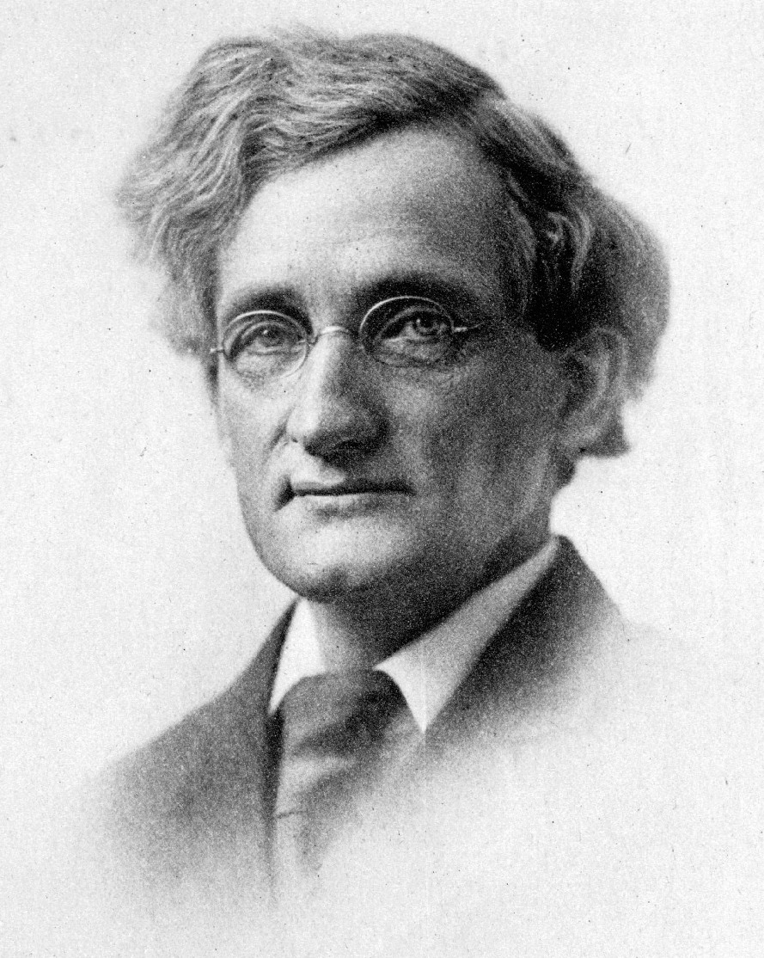
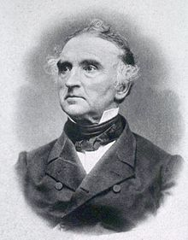
Functional
Integrity
A farming system is sustainable to the extent that it will be regenerated and adaptive over time.
Permanent Agriculture:
A moral duty owed to future generations and to the biosphere itself.
1925
Liberty Hyde Bailey
1858-1954
Agriculture is a physico-chemical process that can be exploited to increase yields & efficient use.
Resource Sufficiency
Agriculture is sustainable if the resources needed to operate it are foreseeably available.
And the specific resources may change over time.
Justus Leibig
1893-1873

Slide 15
Why not bioenergy?
Resource Sufficiency: a technology platform focused on efficiency of global ecosystems.
2025
Functional Integrity: Alternative technology focused on soils, food sovereignty and local ecosystems.
Does a local or regional food system become more robust or more vulnerable when it’s salable products include energy?

Slide 16
What I’m trying to do today…
partial and illustrative
… a broad & inclusive review of the reasons and purposes…
… sensitive to reasons why someone might contest or oppose …
Ethics is a reasoning process designed to explore and answer questions about a proposed course of action that take the form “Is that a good idea?”

Slide 17
Thank-you.
thomp649@msu.edu

